Slide 1
Frege’s Nebengedanke and Grice’s Implicatures (Jornadas Rolando Chuaqui Kettlun, Valparaiso, Chile September 2024)
Marco Ruffino
UNICAMP-Brasil

Slide 2
Frege: “Über Sinn und Bedeutung” (1892)
First half: semantic theory about two semantic values of all expressions: Sinn and Bedeutung
For complete sentences:
Reference (Bedeutung) = Truth Value
Sense (Sinn) = Thought

Slide 3
Frege: subordinate clauses
Second half: “test of the hypothesis” = many exceptions
Most interesting case: subordinate clauses (=discovery of some pragmatic phenomena)
-sentences expressing propositional attitudes
-substantive clauses
-adverbial clauses
-incomplete clauses
…etc.

Slide 4
Frege: subordinate clauses
-some of them have indirect reference (i.e., refer to a thought)
‘Ptolemy thinks that the Sun revolves around the Earth’
-some of them refer to an object (or place or time)
‘The one who discovered the elliptic form of the planetary orbits died in misery’
‘After Schleswig-Holstein was separated from Denmark, Prussia and Austria quarrelled’**
(the latter actually hast two readings, with two distinct phenomena: sentence referring to an object with thought as a sense, or definite description with thought as a presupposition)
[NOTE: Presuppositions, for Frege, is only related to descriptions.]

Slide 5
Frege: subordinate clauses
-some of them express incomplete thoughts:
‘If a number is less than 1 and greater than 0, its square is less than 1 and greater than 0’
-some of them refer to an order or a request:
I order that you bring me the file

Slide 6
Frege: nebengedanke
Most interesting case: when there are more thoughts than clauses
"Almost always, it seems, we connect with the main thoughts expressed by us subsidiary thoughts [“Nebengedanke”] which, although not expressed, are associated with our words, in accordance with psychological laws, by the hearer. And since the subsidiary thought appears to be connected with our words on its own account, almost like the main thought itself, we want it also to be expressed. The sense of the sentence is thereby enriched, and it may well happen that we have more simple thoughts than clauses. In many cases the sentence must be understood in this way, in others it may be doubtful whether the subsidiary thought belongs to the sense of the sentence or only accompanies it.” (SuB, p. 46)

Slide 7
Frege: nebengedanke
Hence, two possibilities for the Nebengedanke:
(i)-They might merely accompany the sentence (in accordance with psychological laws), but are not part of what is expressed;
(ii)-They might actually be part of what is expressed, but only be a subsidiary thought (i.e., not the main thought)

Slide 8
Frege: nebengedanke
(N) Napoleon, who recognized the danger to his right flank, himself led his guards against the enemy position
Three thoughts appear to be expressed:
(1)-Napoleon recognized the danger to his right flank;
(2)-Napoleon led his guards against the enemy position;
(3)-(1) is the cause of (2).
Question: is (3) really expressed, or just accompanies (N) regularly?

Slide 9
Frege: nebengedanke
Frege’s test: can (3) be considered as false without affecting the truth of the whole thought?
YES! $⟹$(3) is merely an accompanying subsidiary thought
No! $⟹$ (3) is part of what is expressed

Slide 10
Frege: nebengedanke
If we go with ‘Yes’ (e.g., the decision was made before Napoleon recognized the danger), (3) is not part of what is said.
I.e., on the one hand, (3) being false does not make (N) false.
On the other hand, we can substitute (1) for any other true sentence and the truth of (N) won’t be affected either.
E.g.,
(N*) Napoleon, who is such that 2+2=4, himself led his guards against the enemy position
is true (although strange)

Slide 11
Frege: nebengedanke
If we go with ‘No’, then a complicated case arises. We cannot substitute (1) with just any other true statements, because then we would have
(N*) Napoleon, who is such that 2+2=4, himself led his guards against the enemy position
expresses:
(1) Napoleon is such that 2+2=4;
(2) Napoleon himself led his guards against the enemy position;
(3) (1) is the cause of (2)
but (3) is false…

Slide 12
Frege: nebengedanke
This means that the sentence
(1)-Napoleon recognized the danger to his right flank
would have to be taken as having two distinct roles in (N):
-once with a truth-value (true) as Bedeutung and expressing the thought that Napoleon recognized the danger to his right flank, and
-once with its indirect reference (the thought itself) and expressing an indirect sense

Slide 13
Frege: nebengedanke
This seems strange, but it is what happens in less controversial cases
(B) Bebel fancies [wähnt] that the return of Alsace-Lorraine would appease France’s desire for revenge
expresses two thoughts:
(1)-Bebel believes that the return of Alsace-Lorraine would appease France’s desire for revenge
(2)-The return of Alsace-Lorraine would NOT appease France’s desire for revenge
In (1) the subordinate clause has its indirect reference, while in (2) has its direct reference (the false, according to Frege)
NOTE: ‘fancies’ is counterfactive, but the same happens with factive verbs such as ‘knows’, ‘realizes’, etc.

Slide 14
Frege: nebengedanke
(W) Because ice is less dense than water, it floats on water
(1)-Ice is less dense than water.
(2)-If anything is less dense than water, it floats on water.
(3)-Ice floats on water
Again, (1) is taken in its direct reference (true) in (1) and expresses the thought that ice is less dense than water, but it also expresses part of the thought in (2) (hence, cannot be substituted with just any other true thought, e.g., ’2+2=4’)

Slide 15
Important Features
-In many situations, the accompanying Nebengedanke is so natural that we don’t notice it;
-The Nebengedanke that is part of what is expressed may be triggered by expressions (e.g., ‘because’);
-In many situations (as in the causal clause) the Nebengedanke may be what most interest us.
-Despite all this, the Nebengedanke are not part of the logical (conceptual) content of judgements, and hence do not have a place in logical reasoning.

Slide 16
Nebengedanke in Logic
Danger specifically in logic:
“Letter to Husserl” (1906): Existential import of universal quantification
All unicorns are nice $⟹$ There are unicorns
“Dialog with Pünjer on Existence”: residual reading of existential claims
Some humans are Greeks $⟺$ Some Greeks are human
But
Some Greeks are human $“⟹$” Some Greeks (most of them?) are not human
while
$\text{Some} \text{humans} \text{are} \text{Greeks}”⇏$” Some Greeks are not human

Slide 17
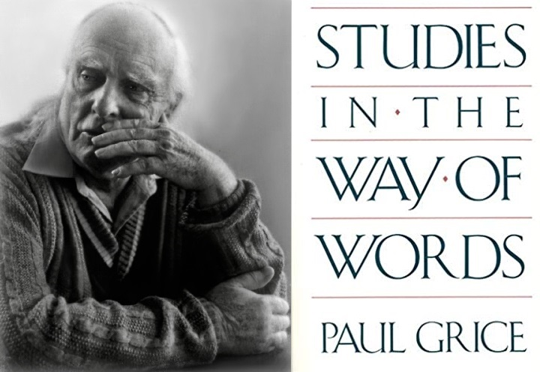
Implicatures
Grice (1967)
Phenomenon: Implicatures (Conversational and Conventional)
General Structure:
In saying P, the speaker transmits the information that P and Q
Where Q is calculated by the hearer so as to harmonize what was said with some Conversational Maxims (i.e., principles of rational cooperation in communication)

Slide 18
Implicatures: two kinds
Grice
1-NON-CONVENTIONAL
(i.e., not strictly governed by the conventional meaning)
1.i-Particularized (=high contextual dependence)
E.g.,
-Irony:
A: ‘What a nice person!’ [said of someone who just did something bad...]
B understands: This is a bad person

Slide 19
Implicatures: two kinds
1.ii-Generalized
(Works in several contexts)
E.G.,
‘He is seeing a woman tonight’
We usually understand: he will see a woman that is not his wife (or mother, etc.)
‘He entered a house’
We usually understand: he entered a house that is not his house
‘He entered the house’
We usually understand: he entered a house that was previously mentioned in the conversation

Slide 20
Implicatures: two kinds
2. CONVENCIONAL (i.e., triggered (but not logically implied) by the conventional meaning)
“In some cases the conventional meaning of the words used will determine what is implicated, besides helping to determine what is said. If I say (smugly), He is an Englishman; he is, therefore, brave, I have certainly committed myself, by virtue of the meaning of my words, to its being the case that his being brave is a consequence (follows from) his being an Englishman. But while I have said that he is an Englishman, and said that he is brave, I do not want to say that I have said (in the favored sense) that it follows from his being an Englishman that he is brave, though I have certainly indicated, and so implicated, that this is so. I do not want to say that my utterance of this sentence would be, strictly speaking, false should the consequence in question fail to hold.” (Grice, “Logic and Conversation”, pp. 25-6)

Slide 21
Frege: nebengedanke
Standard interpretation: two kinds of Nebengedanke correspond to the two sorts of implicatures, although Grice locates the cause of them in principles of rational conversation (maxims) while Frege in the psychology of speaker and hearer

Slide 22
Frege: nebengedanke
Frege: wants to eliminate from the language of pure thoughts both kinds of implicature:
“If it is a task of philosophy to break the power of the word over the human mind, uncovering illusions which through the use of language often almost unavoidably arise concerning the relations of concepts, freeing thought from that which only the nature of the linguistic means of expression attaches to it, then my Begriffsschrift, further developed for these purposes, can become a useful tool for philosophers.” (Begriffsschrift, Preface, CN p. 106)

Slide 23
Frege: nebengedanke
“That is why we cannot give too many warnings against the danger of confusing points of view and switching from one question to another, a danger to which we are particularly exposed because we are accustomed to thinking in some language or other and because grammar, which has for speech a significance analogous to that which logic has for thought, is a mixture of the logical and the psychological.” (“Logic” (1879/91), PW p. 6)

Slide 24
A different interpretation
Sander (2021): challenges this interpretation, especially the two examples
Two arguments:
1-In the Bebel case: what is main thought and what is subsidiary thought might change from context to context

Slide 25
A different interpretation
2-In the ice and water causal case, the causal connection cannot be the subsidiary thought, for it is exactly the point of uttering the causal clause using ’because’.
He proposes instead the “multipropositional” view

Slide 26
Against the different interpretation
Against argument (1):
-One thing is the classification of thoughts as main or as subsidiary thought(s), depending on the fact that a thought is expressed by the main and the subordinate clause. Quite another thing is the relevance that we give to the subsidiary thought, which may be sometimes greater than the importance of the main thought(s).

Slide 27
Against the different interpretation
Against argument (2):
-The point is not so much that the subsidiary thought cannot be made explicit, as Sander assumes. It is rather that it occurs only when there is a special kind of interaction between the two thoughts, so that they together express a third (extra) thought.
-There is no problem in seeing the subsidiary thought as the main point of an utterance. It does not destroy its status as “subsidiary”, anymore than the main point of an utterance might be not the primary content but the conventional implicature (in Grice’s model).
Against both arguments:
-There is a substantive (i.e., not contextual) property of subsidiary thoughts in Frege’s example: it involves some switch in Bedeuntung (i.e., from direct to indirect or otherwise) of some thought that occurred as the main thought or as one of the main thought.

Slide 28
Some Conclusions
1-the original interpretation is better grounded;
2-Frege anticipated the detection of the phenomenon of both conventional and conversational implicature with Nebengedanke;
3-Very important: this phenomenon is distinct from the phenomenon of presuppositions (Letter to Husserl)

Slide 29
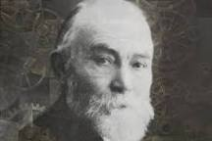
Vielen Dank!

